Slide 1
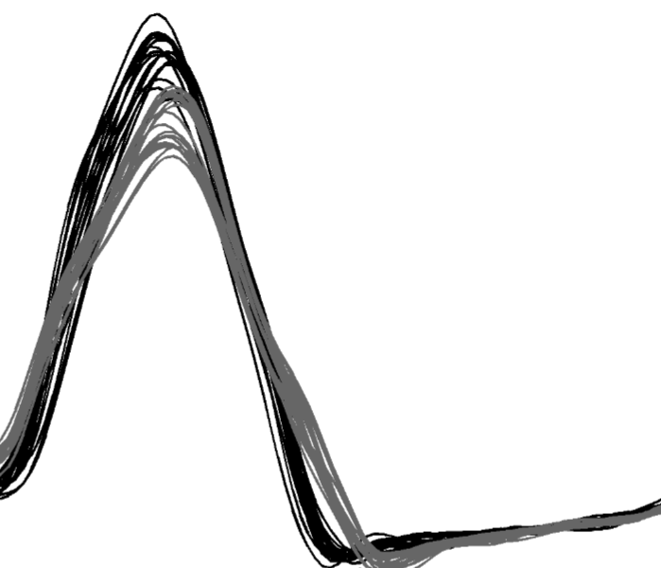
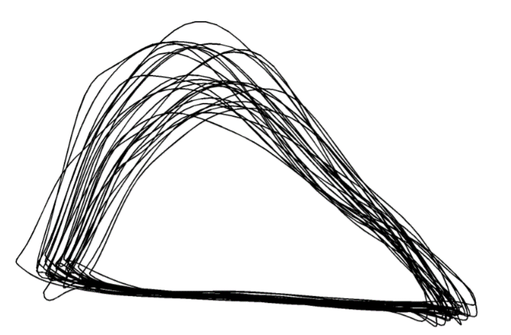
Advanced Statistical Analysis of Biomechanical Time Series
Principal Components Analysis
Functional Data Analysis
Statistical Parametric Mapping
Todd Pataky
Mark Robinson
Drew Harrison
John Warmenhoven
Department of Health and Human Sciences, Kyoto University
Research Institute for Sport and Exercise Sciences, Liverpool John Moores University
Physical Education and Sport Sciences, University of Limerick
Exercise & Sports Science, University of Sydney

Slide 2
What’s being explored…
Descriptive Statistics
SPM t-test
SnPM t-test
FDA t-test
fPCA
All to the same data set…
Barely scratching the surface!
Notes:
Talk to this slide.

Slide 3
Research Question
Simulated data was created using data from:
Warmenhoven, J., Harrison, A. J., Robinson, M. A., Vanrenterghem, J., Bargary, N., Smith, R., . . . Pataky, T. (2017). A comparison of functional data analysis and statistical parametric mapping in sports biomechanics: The independent samples t-test. Journal of Science & Medicine in Sport, In Press.
Compared FDA, SPM and SnPM on the same data set.
Independent samples t-test.
Questions
Are gender differences in force application during on-water rowing consistent across the entire movement cycle?
Are each of the techniques similar/different in how they report on these differences?
Notes:
Talk to this slide.

Slide 4
Data Set
Bow-side of the boat for the demonstration.
Highly trained, experienced rowers (10 males and 10 females).
Rowing at 32 strokes per minute for 250m. Average taken of 10 consecutive strokes.
Load sample data:
load(‘Simulated_Data’);
Add file paths:
addpath('E:\1. WCB Workshop\fdaM\')
addpath('E:\1. WCB Workshop\spm1dmatlab-master\')
addpath('E:\1. WCB Workshop\spm1dmatlab-master\spm8’)
To get access to these functions visit www.functionaldata.org and www.spm1d.org.
Notes:
Explain why we are using simulated data.

Slide 5
Descriptive Statistics
Mean and standard deviation clouds are useful descriptive statistics for inspection of differences between experimental groups.
These can be plotted easily using the spm1d.org software:
[Insert Here with Graph]
Notes:
Todd would you be able to help here?

Slide 6
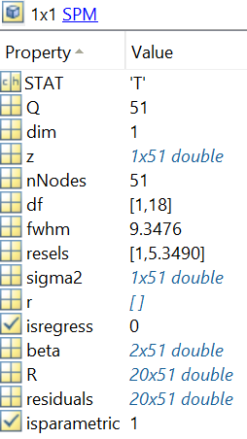
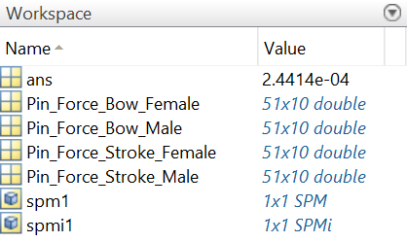
SPM T-Test
spm1 = spm1d.stats.ttest2(Pin_Force_Bow_Male' Pin_Force_Bow_Female');
spmi1 = spm1.inference(0.05, 'two_tailed’,true);
z = T-statistic
Notes:
More for Todd, but we can certainly talk more about the other variables (other than just the T-statistic).

Slide 7
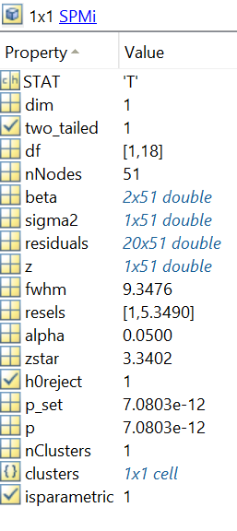
SPM T-Test
spm1 = spm1d.stats.ttest2(Pin_Force_Bow_Male' Pin_Force_Bow_Female');
spmi1 = spm1.inference(0.05, 'two_tailed’,true);
z = T-statistic
zstar = Crit T-statistic
p = p-value for each significant region
Notes:
More for Todd, but we can certainly talk more about the other variables (other than just those listed).

Slide 8
SPM T-Test
figure(101)
spmi1.plot();
spmi1.plot_threshold_label();
spmi1.plot_p_values();
Notes:
Talk to this slide.

Slide 9
SPM T-Test
figure(101)
spmi1.plot();
spmi1.plot_threshold_label();
spmi1.plot_p_values();
Notes:
Talk to this slide.

Slide 10
SPM T-Test
figure(101)
spmi1.plot();
spmi1.plot_threshold_label();
spmi1.plot_p_values();
Notes:
Talk to this slide.

Slide 11
SPM T-Test
figure(101)
spmi1.plot();
spmi1.plot_threshold_label();
spmi1.plot_p_values();
Notes:
Talk to this slide.

Slide 12
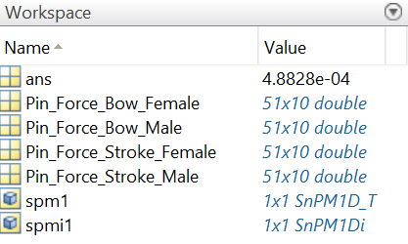
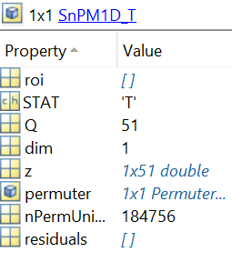
SnPM T-Test
spm1 = spm1d.stats.nonparam.ttest2(Pin_Force_Bow_Male', Pin_Force_Bow_Female');
spmi1 = spm1.inference(0.05, 'two_tailed',true, 'force_iterations',true, 'iterations', 184756);
z = T-statistic
Notes:
Similar to SPM slides.

Slide 13
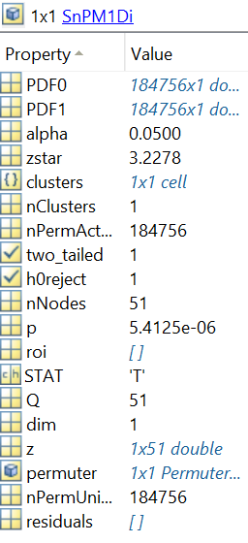
SnPM T-Test
spm1 = spm1d.stats.nonparam.ttest2(Pin_Force_Bow_Male', Pin_Force_Bow_Female');
spmi1 = spm1.inference(0.05, 'two_tailed',true, 'force_iterations',true, 'iterations', 184756);
z = T-statistic
zstar = Crit T-statistic
p = p-value for each significant region
Notes:
Similar to SPM slides.

Slide 14
SnPM T-Test
figure(101)
spmi1.plot();
spmi1.plot_threshold_label();
spmi1.plot_p_values();
Notes:
Talk to this slide.

Slide 15
SnPM T-Test
figure(101)
spmi1.plot();
spmi1.plot_threshold_label();
spmi1.plot_p_values();
Notes:
Talk to this slide.

Slide 16
SnPM T-Test
figure(101)
spmi1.plot();
spmi1.plot_threshold_label();
spmi1.plot_p_values();
Notes:
Talk to this slide.

Slide 17
SnPM T-Test
figure(101)
spmi1.plot();
spmi1.plot_threshold_label();
spmi1.plot_p_values();
Notes:
Talk to this slide.

Slide 18
FDA Preparatory Steps
Setting up a time interval:
time = linspace(0, 100, 51)’;
Estimation of functions using a basis expansion:
forcebasis = create_bspline_basis([0,100], 51, 6);
Setting up the penalty for roughness by defining a linear differential operator:
Lfdobj = int2Lfd(4);
Setting up the functional parameter object that defines the amount of smoothing:
smoothing_parameter = 1e-15;
forcefdPar = fdPar(forcebasis, Lfdobj, smoothing_parameter);
Once details are settled on, they can be combined with the basis expansion to fit curves into functional data objects:
Pin_Force_Bow_Female_fd = smooth_basis(time, Pin_Force_Bow_Female, forcefdPar);
Pin_Force_Bow_Male_fd = smooth_basis(time, Pin_Force_Bow_Male, forcefdPar);
Notes:
Mention that there are more options for smoothing than just b-splines.
Check with Norma about the 4 options for int2Lfd function and why you would pick one over another.

Slide 19
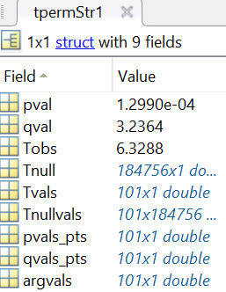
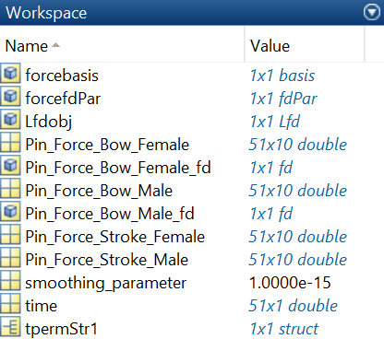
FDA T-Test
FDA t-test and the tperm_fd function:
tpermStr1 = tperm_fd(Pin_Force_Bow_Male_fd, Pin_Force_Bow_Female_fd, 184756, 0.05);
Tvals = T-Statistic
qval = Crit T-Statistic
pval = p-value for region identified as being significant between groups.
Notes:
Talk to this slide.

Slide 20
FDA T-Test
Setting up a time interval:
tpermStr1 = tperm_fd(Pin_Force_Bow_Male_fd, Pin_Force_Bow_Female_fd, 184756, 0.05);
Tvals = T-Statistic (blue)
qval = Crit T-Statistic (red dotted)
pval = p-value for region identified as being significant between groups.
Notes:
Talk to this slide.

Slide 21
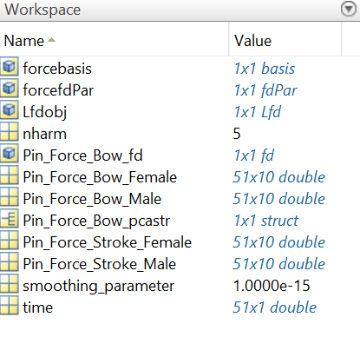
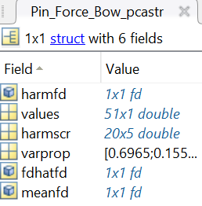
Functional PCA (fPCA)
Follow FDA preparatory steps…
Setting up a functional data object for all curves together:
Pin_Force_Bow_fd = smooth_basis(time, [Pin_Force_Bow_Male Pin_Force_Bow_Female], forcefdPar);
Define how many functional principal components (fPCs) you wish to retain:
nharm = 5;
Carry out fPCA:
Pin_Force_Bow_pcastr = pca_fd(Pin_Force_Bow_fd, nharm, forcefdPar);
Notes:
There is also potential to smooth fPCs (given they are functions) the same way that you would smooth functions as a part of the basis expansion fitting process. We have selected the same negligible parameter that was used in the original fitting process.

Slide 22
Functional PCA (fPCA)
The FDA software package comes with its own ability to visual fPCs:
plot_pca_fd(Pin_Force_Bow_pcastr, 0, 0, 0, 0, 0);
fPCs are added (+ line) and subtracted (– line) from the mean to demonstrate the behaviour of positive and negative scorers.
There can be better ways to graph however…
Notes:
The package has the ability to do a quick visualization, but it isn’t great.

Slide 23
Functional PCA (fPCA)
Define the mean function and the harmonic (fPC) functions:
Forcemeanfd = mean(Pin_Force_Bow_fd);
Forceharmfd = Pin_Force_Bow_pcastr.harmfd;
Unwrap them to vectors of points:
Forcemeanvec = squeeze(eval_fd((time), Forcemeanfd));
Forceharmmat = eval_fd(time, Forceharmfd);
Define the fPC scores and the between subject standard deviation of these scores for each fPC:
Forcescores = Pin_Force_Bow_pcastr.harmscr;
stdevfPCscores = std(Forcescores);
Define a constant to expand each the fPCs (in this case we have used 1 x SD of the fPC scores):
con1 = stdevfPCscores(1)*1;
Use the constant and expand each fPC, then add and subtract that expanded fPC onto the mean function:
fPC1_Pos = Forcemeanvec + con1.*(Forceharmmat(:,1));
fPC1_Neg = Forcemeanvec - con1.*(Forceharmmat(:,1));
Roll this into the one figure…
Notes:
Tall to this.

Slide 24
Functional PCA (fPCA)
figure(110)
phdl = plot(time, Forcemeanvec, 'k-');
set(phdl, 'LineWidth', 1.5)
hold on
phdl = text(time, fPC1_Pos, '+');
set(phdl, 'LineWidth', 1.5)
hold on
phdl = text(time, fPC1_Neg, '-');
set(phdl, 'LineWidth', 1.5)
hold off
box on
set(gca,'FontSize',10);
title('\fontsize{10} fPC1');
xlabel('\fontsize{10} Drive Phase (%)')
ylabel('\fontsize{10} Force (N)')
axis([0,100,-100,700])
Notes:
Talk to this.

Slide 25
Functional PCA (fPCA)
figure(112)
scatter(Forcescores(1:10,1),Forcescores(1:10,2), 'b');
hold on
scatter(Forcescores(11:20,1),Forcescores(11:20,2), 'r');
hold off
box on
set(gca,'FontSize',10);
title('\fontsize{10} fPC1 vs fPC2');
xlabel('\fontsize{10} fPC1 Scores')
ylabel('\fontsize{10} fPC2 Scores')
axis([-1000,1000,-400,400])
Notes:
Clearly fPC1 scores show discrimination between the two groups.

